Slide 1
Brain Structure
Learning Objectives:
Identify the 4 different lobes of the brain and their functions
Explain one result of injury to each of the lobes of the brain

Slide 2
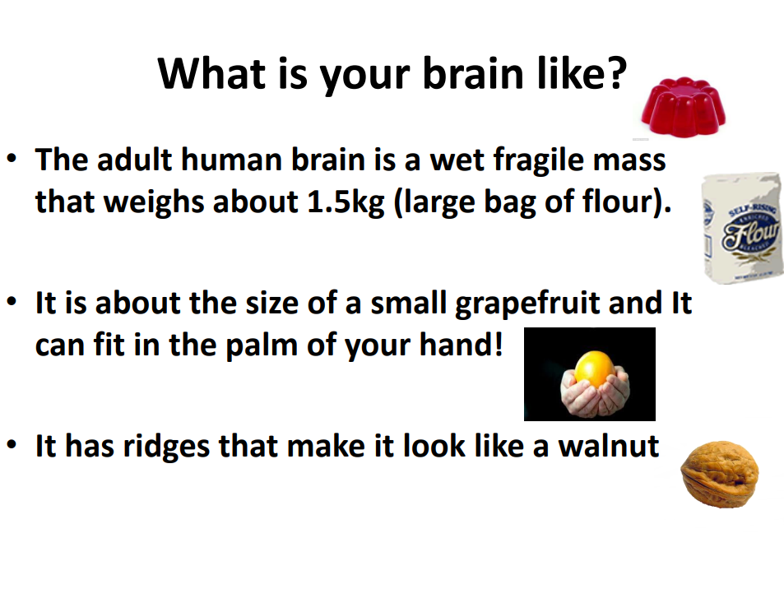

Slide 3
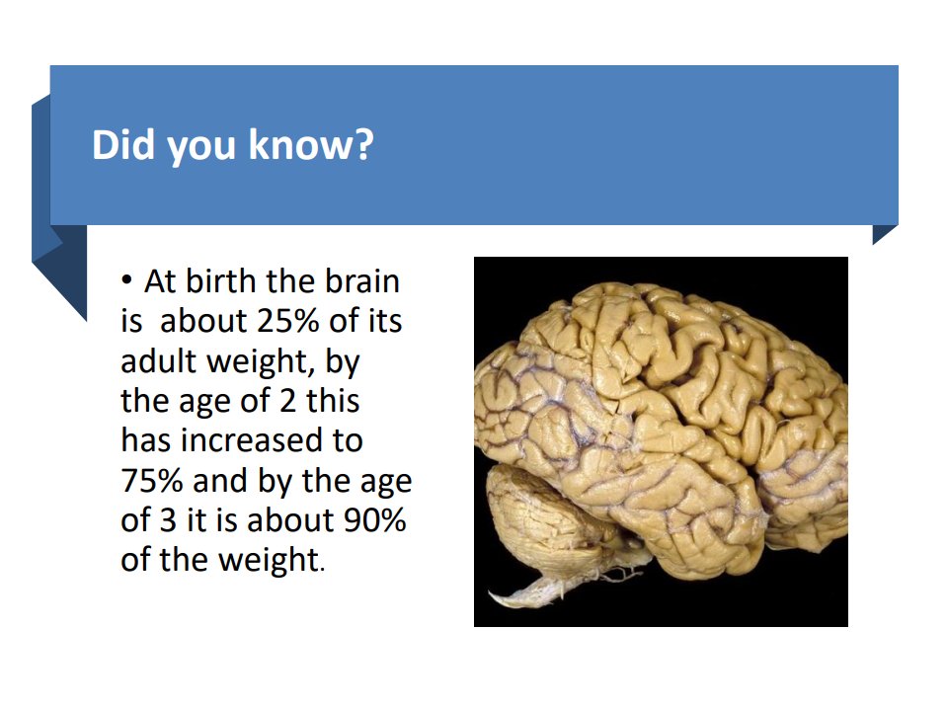

Slide 4
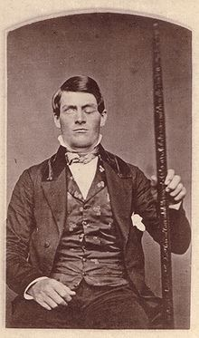
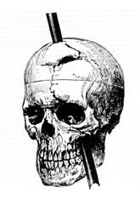
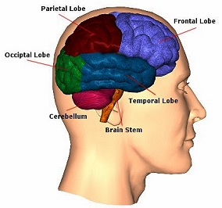
Phineas Gage: a railway worker who was injured by an iron railway spike through his head
The spike destroyed a large part of the brain called the frontal lobe
Gage survived but...
... his personality was very different from before
Conclusion:
The frontal lobes of the brain are important for personality

Slide 5


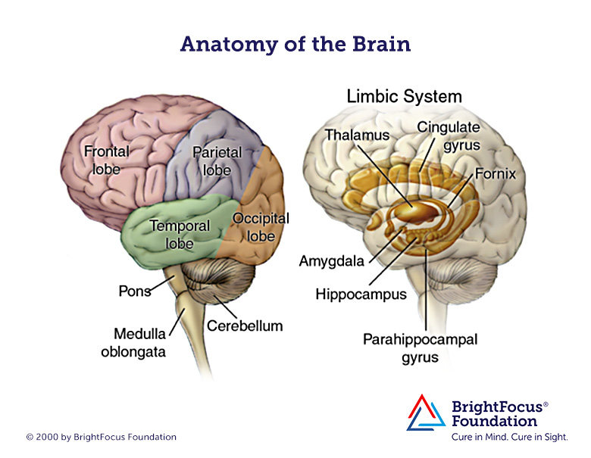
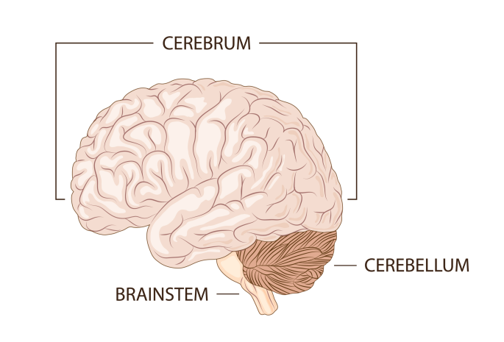
The cerebrum (lobes) and the Limbic system

Slide 6
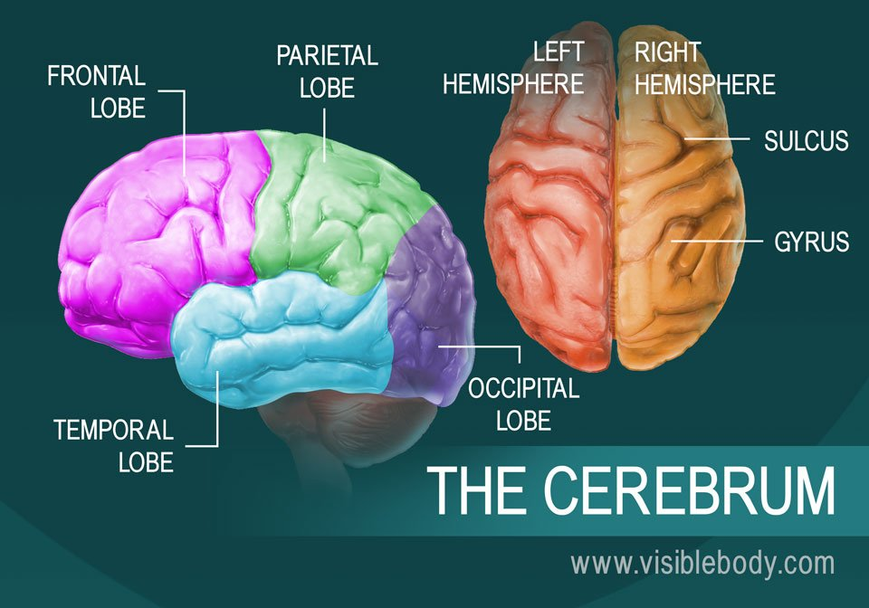
The cerebrum
The cerebrum (front of brain) comprises gray matter (the cerebral cortex) and white matter at its center. The largest part of the brain, the cerebrum initiates and coordinates movement and regulates temperature and stores memories.

Slide 7
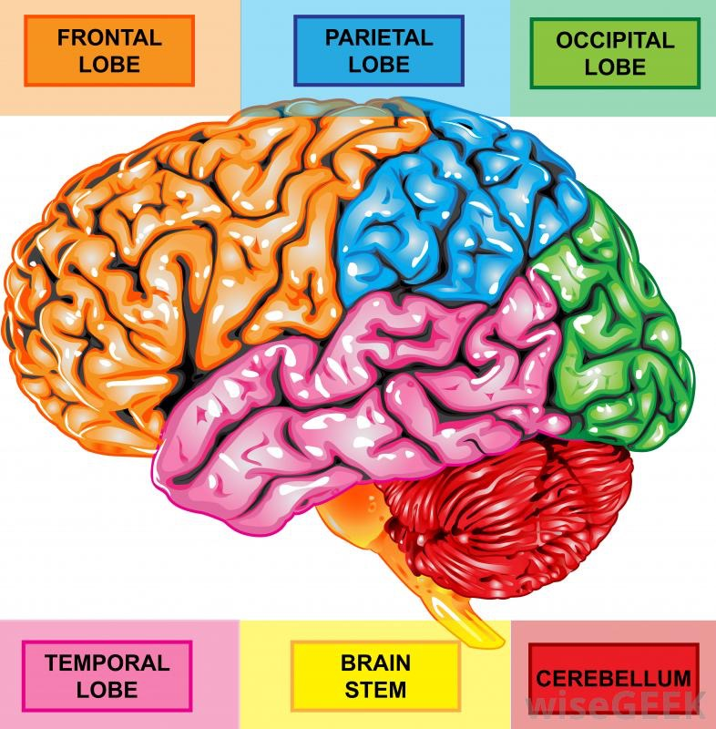
The cerebral lobes
Frontal Lobe: Reasoning, motor skills, higher level cognition and language.
It helps with:
Decision making
Problem solving
Planning
Your personality traits

Slide 8
The cerebral lobes
Parietal Lobe: Processes sensory information.
Helps you with:
Taste
Feel temperature
Touch
Processing sensory information
Coordination

Slide 9
The cerebral lobes
Occipital Lobe: Interprets visual stimuli.
It helps you to
Make sense of what we are seeing from visual information
Make sense of emotional information conveyed through body language

Slide 10
The cerebral lobes
Temporal Lobe: Formation of memory, have input to mood and emotion. Interprets sounds and language.
This part of the brain:
Hearing and selective listening
Memory formation

Slide 11
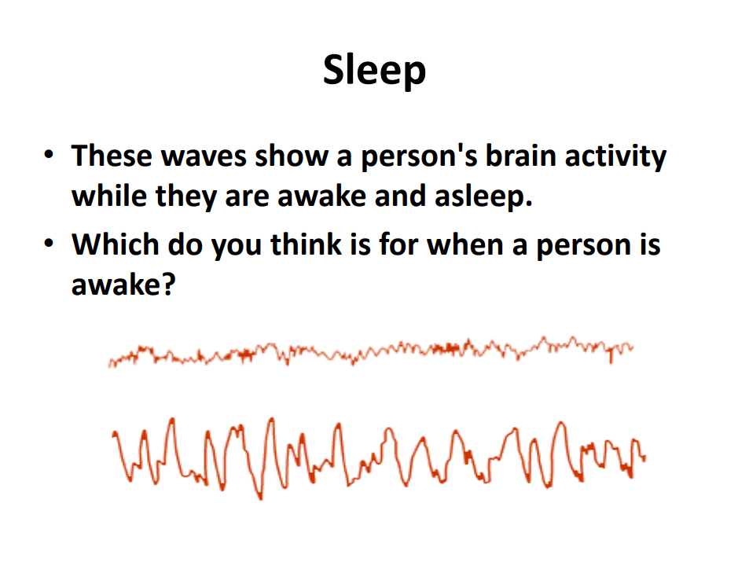

Slide 12
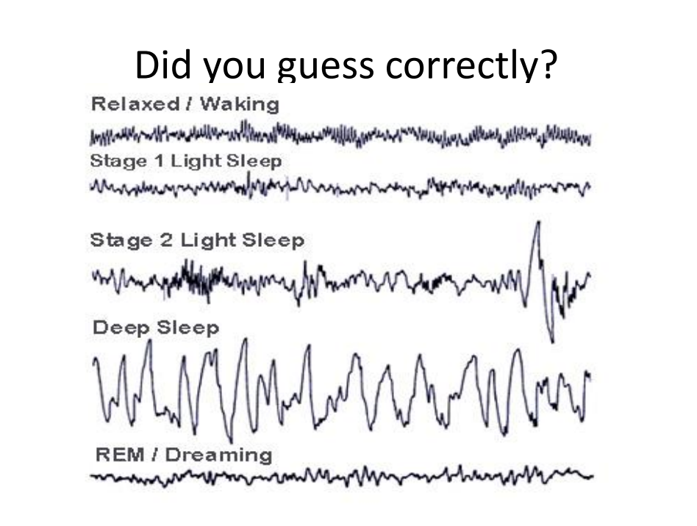

Slide 13
The limbic system
The limbic system is a set of primitive brain structures located on top of the brainstem and buried under the cerebrum.
The limbic system is the part of the brain involved in our behavioral and emotional responses, especially when it comes to behaviors we need for survival: feeding, reproduction and caring for our young, and fight or flight responses.

Slide 14
